Slide 1
JavaScript is Everywhere
Stoyan Stefanov
OSCON July 27, 2011

Slide 2
The Future is here
and it's widely distributed

Slide 3
"Write once, run everywhere"
JavaScript is everywhere

Slide 4
Learn one language
do everything

Slide 5



Slide 6
I'm biased
so let's just do it

Slide 7



Slide 8
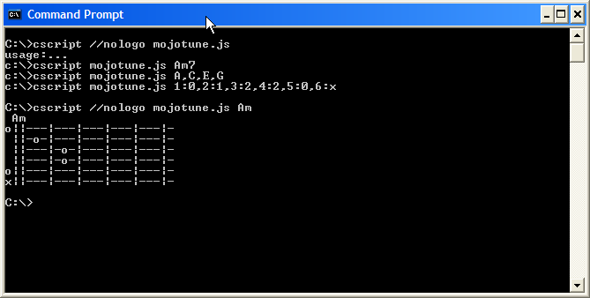

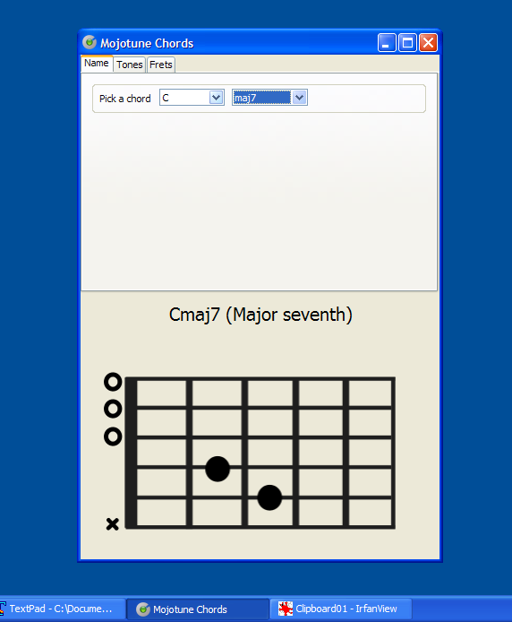
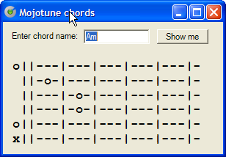
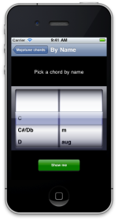
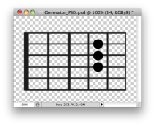
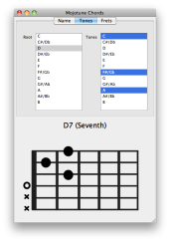
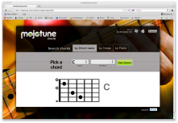
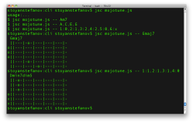
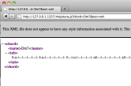

Slide 9
MVC?
In-M-Out

Slide 10
In-M-Out
Input
Model
Output
-> UI, presentation
-> "Business" logic, core, brains
-> UI, presentation

Slide 11
and the rest is…
CODE & DEMOS

Slide 12
m.js
knows all the chords

Slide 13
CLI
command-line interface

Slide 14
CLI
jsc
rhino
node
cscript
exe

Slide 15
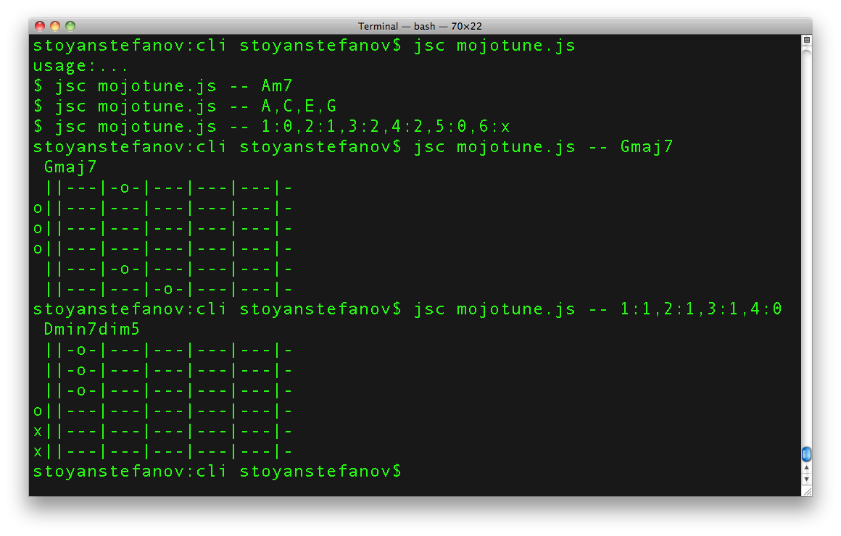

Slide 16
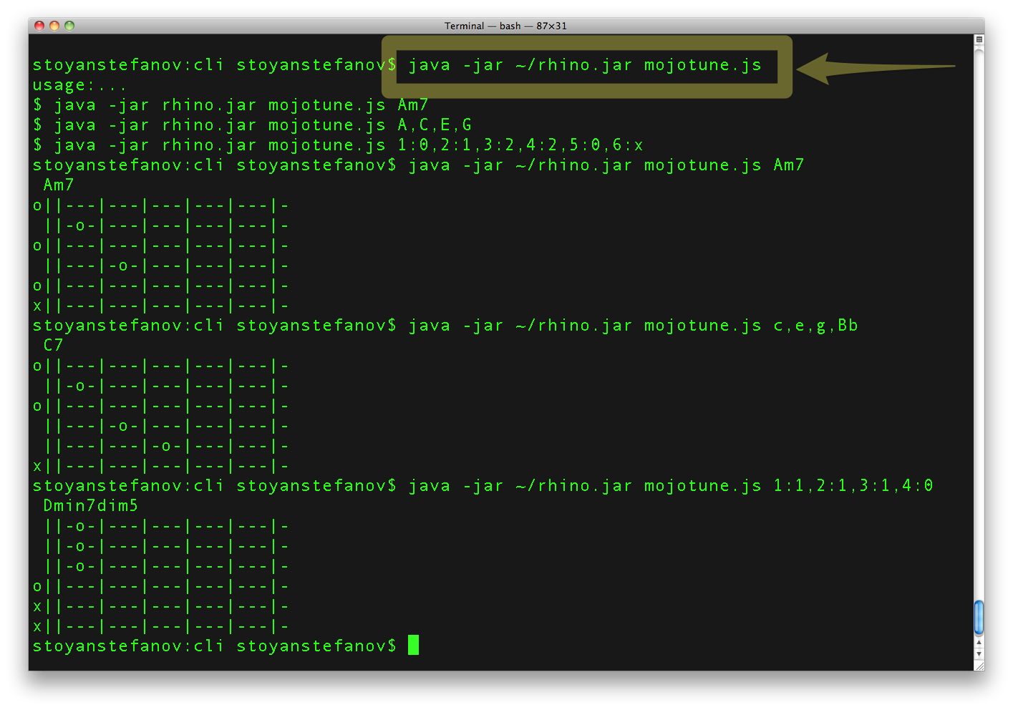

Slide 17
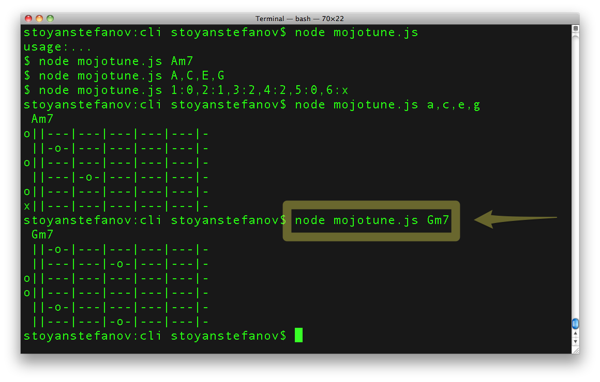

Slide 19
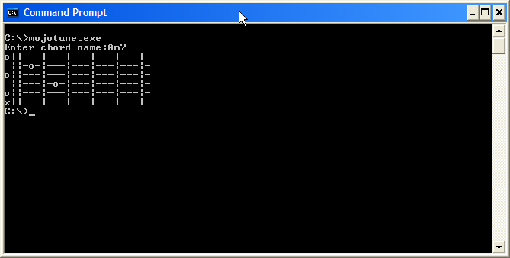

Slide 21
WebService
with node.js

Slide 22
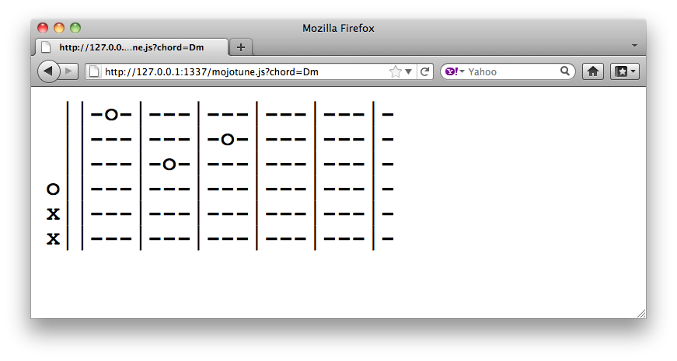

Slide 23


Slide 24
Web Site/App
JavaScript's natural habitat: the browser

Slide 25
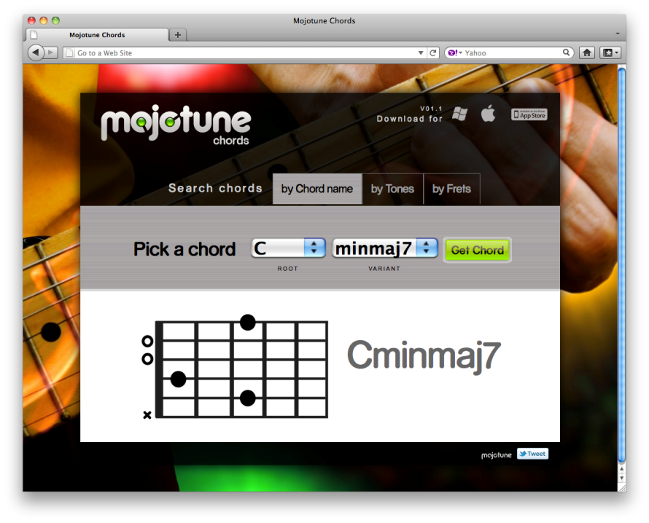

Slide 26
Bookmarklet
smaller version of web
(thanks, media queries!)

Slide 27
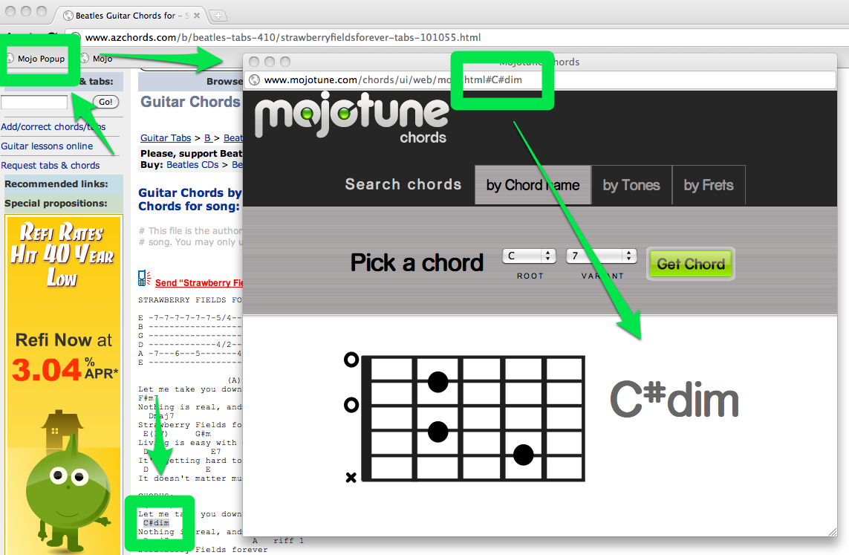

Slide 28
Browser extension

Slide 29
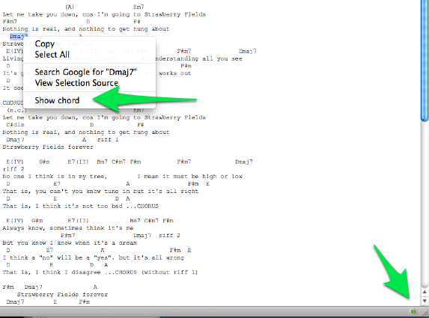

Slide 30
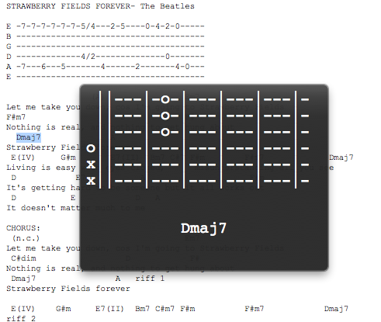

Slide 31
Photoshop scripting
to generate 100s chord PNGs

Slide 32
Photoshop
IDE: ExtendScript Toolkit
log actions to .js
app
  .documents[0]
  .layers
  .getByName('ha')
  .visible = true;

Slide 33
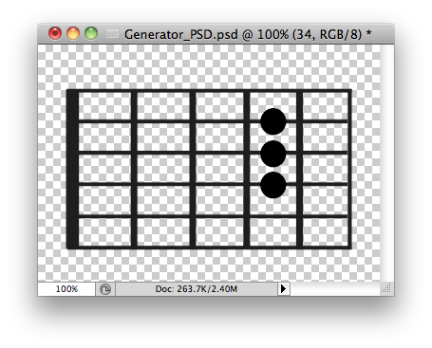
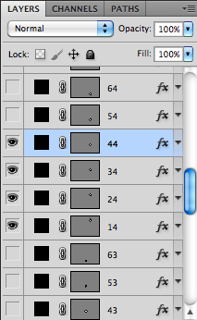

Slide 34
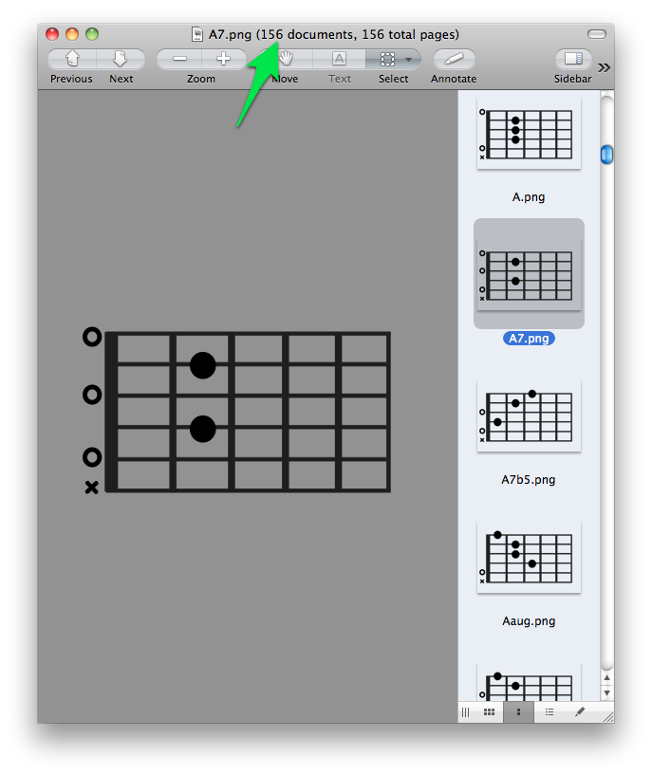

Slide 35
Desktop app
for Mac, Windows, Linux via XULRunner

Slide 37
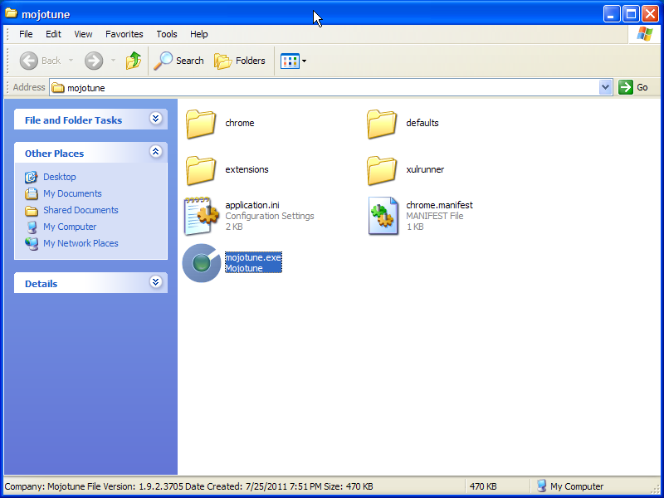

Slide 38
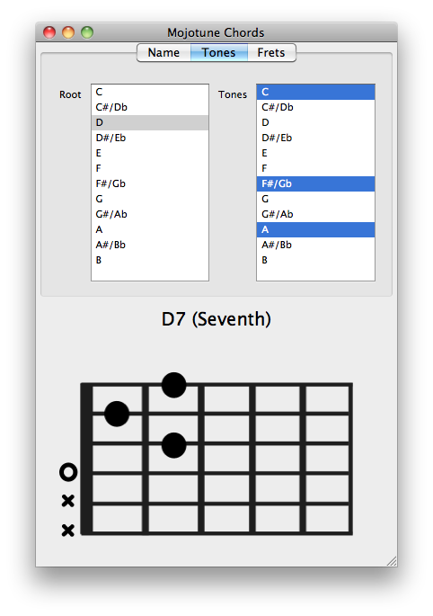

Slide 39
More desktop
for Windows

Slide 40
lib and exe
DLL
Windows .exe

Slide 41
Native iPhone app
with Titanium

Slide 42
Options
Titanium Mobile:
  compiles JS to Obj-C
PhoneGap
  Runs your JS/HTML(5)
  starts with about:blank-like page
  need a JS toolkit, e.g. Sencha Touch or jQuery Mobile to mimic native controls

Slide 43
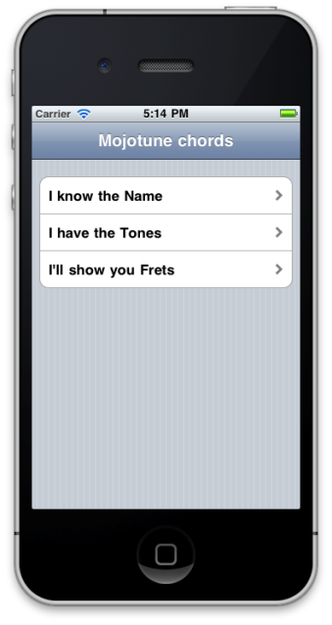
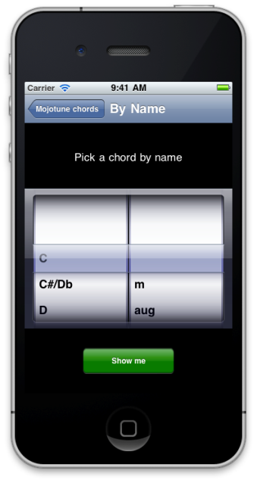

Slide 44
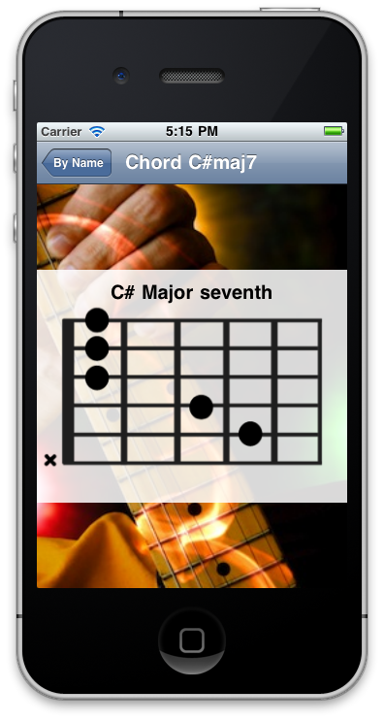

Slide 45
And more…
Titanium desktop
Mac Widgets
Yahoo Widgets – work on TVs too
Adobe Air
PhoneGap (+Sencha Touch)
Next Windows OS
…

Slide 46
JavaScript everywhere
If you're on a deserted island with virtually any device (and infinite battery life) you can still write code and be creative

Slide 47
Just type this URL:
javascript:alert(eval(prompt('What?')))

Slide 48
Stoyan Stefanov
@stoyanstefanov http://phpied.com/files/jseverywhere.zip
Thank you!

